Slide 1
Inflation and Depreciation

Slide 2


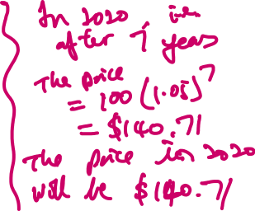



Inflation
The price of an electric frying pan was $100 in 2013. The price of the flying pan increase 5% p.a. What is the price of the frying pan in 2016? What about the price in 2020?

Slide 3
Repeated increase
2013
2014
2015
2016
$100
$105
$110.25
$115.76
5%
5%
5%

Slide 4











Example 2
Population in a rural community was 3,521 in 2010. Since then, the population has increased by an average of 6% p.a. for the next four years.
Calculate the population in the rural community after 3 years.
What is the percentage increase in population over the three years? (to the nearest 0.1%)

Slide 5
INFLATION (Increase)
Multiply by (1+X%) (1+X%) (1+X%)
X%
X%
X%
Original amount
Final amount
Final amount = original amount (1 + X%)^{n}

Slide 6



Depreciation
During the Christmas sale, a set of cutlery was discounted by 30%. At the end of the sale, the cutlery set was further discounted by another 30%. If the original price of the set was $120, what is the final price?

Slide 7











Marcus bought a car at $28 000 in 2016. The value of the car depreciated at a rate of 3% p.a.
What is the value of the car in 2018.
He intends to sell his car after 10 years, what is the value of his car then?

Slide 8
Depreciation (Decrease)
Multiply by (1-X%) (1-X%) (1-X%)
X%
X%
X%
Original amount
Final amount
Final amount = original amount (1 - X%)^{n}

